Slide 1
Observer design pattern

Slide 2
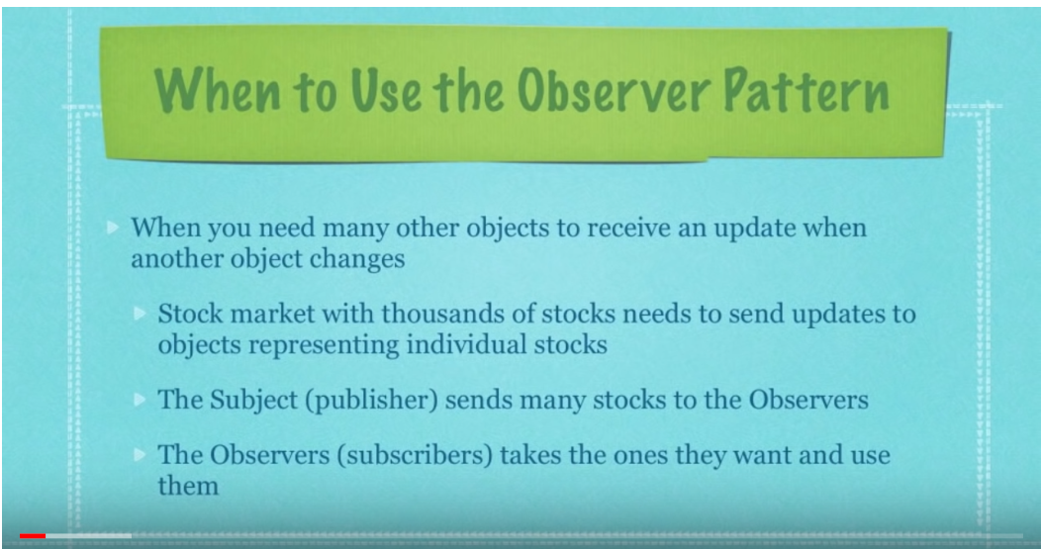

Slide 3
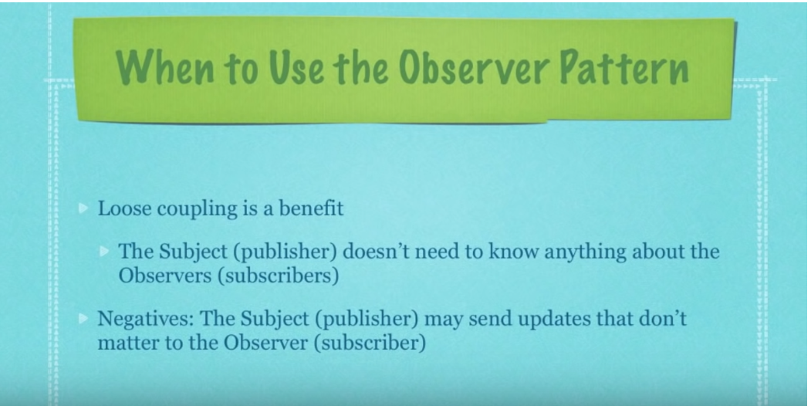

Slide 4
